Slide 1
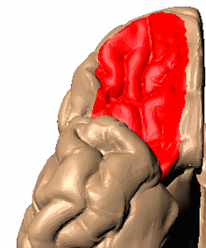
The State Space Theory of OFC
R
S1
L
Bob Wilson
R
S2
L

Slide 2






Neuroscience of Reinforcement Learning and Decision Making Lab

Slide 3
Neuroscience of Reinforcement Learning and Decision Making Lab The NRD lab
Notes:
Aging context

Slide 4
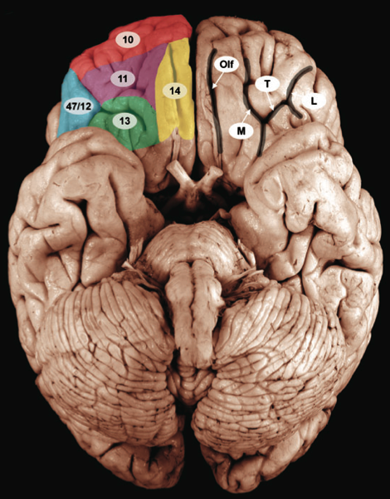
Orbitofrontal cortex (OFC)
Big
Well connected
Inputs from all sensory modalities
Dopaminergic inputs
Reciprocal connections to striatum and amygdala
Inputs from hippocampus
from Wallis 2007

Slide 5
What does the OFC do?
Nothing!
Patients with OFC lesions have no deficits in lab tests of memory, language, IQ etc ...
Insurers refused to pay for treatment
But ...
They have major deficits in life tests
Notes:
Mention insurance companies refusing to pay for treatment and disability benefits

Slide 6
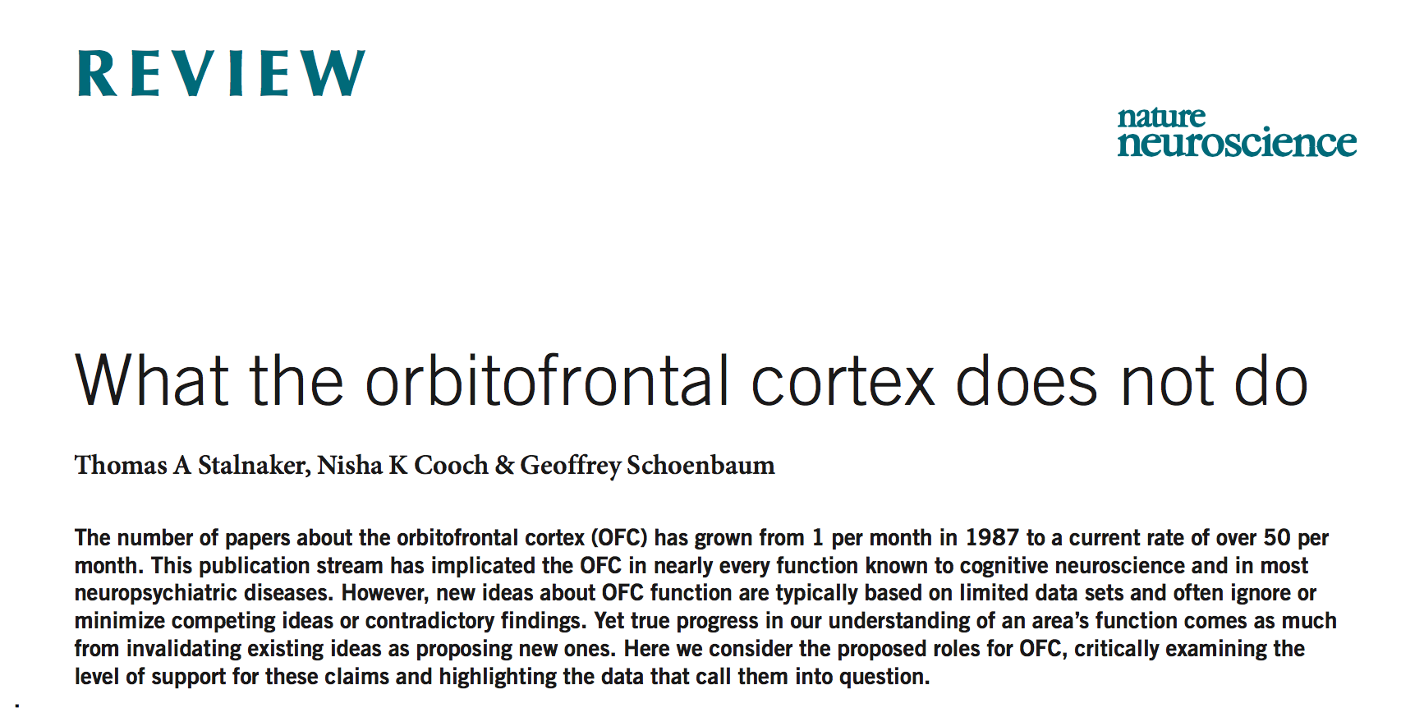
What does the OFC do?
Everything!
Neurons in OFC code:
Stimulus identity
Value
Confidence
Past actions, etc …
implicated the OFC in nearly every function known to cognitive neuroscience and in most neuropsychiatric diseases
Notes:
Mention insurance companies refusing to pay for treatment and disability benefits

Slide 7
OFC codes the state space for reinforcement learning
Wilson et al. Neuron 2014

Slide 8
OFC codes the state space for reinforcement learning The State Space Theory for OFC
Wilson et al. Neuron 2014

Slide 9
What is a state space?

Slide 10
What is a state space?
An abstraction of the current task that facilitates learning and decision making

Slide 11
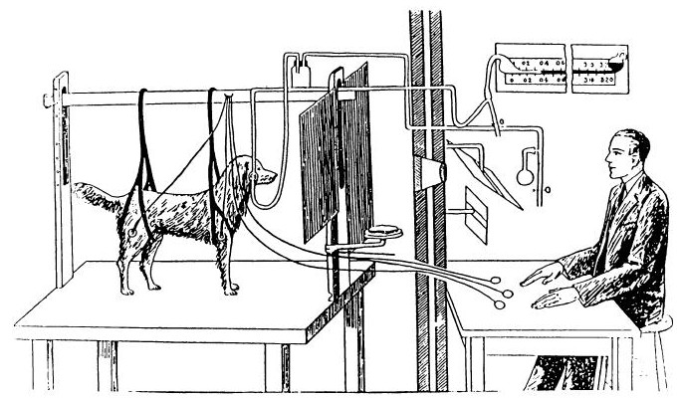
What is a state space?
An abstraction of the current task that facilitates learning and decision making

Slide 12
What is a state space?
initial
bell
reward

Slide 14
Monday
bell
reward
Friday
bell
no reward

Slide 15
Outline
Example of State Space Theory:
Effect of OFC lesions on Delayed Alternation
fMRI evidence for State Space Theory
Faces/Houses task
Towards a mathematical account of State Space Theory
Can humans do linear regression?

Slide 16
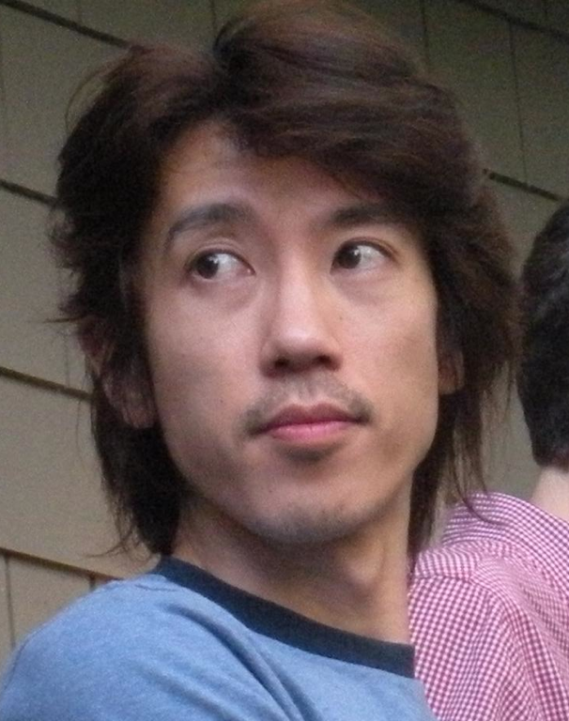
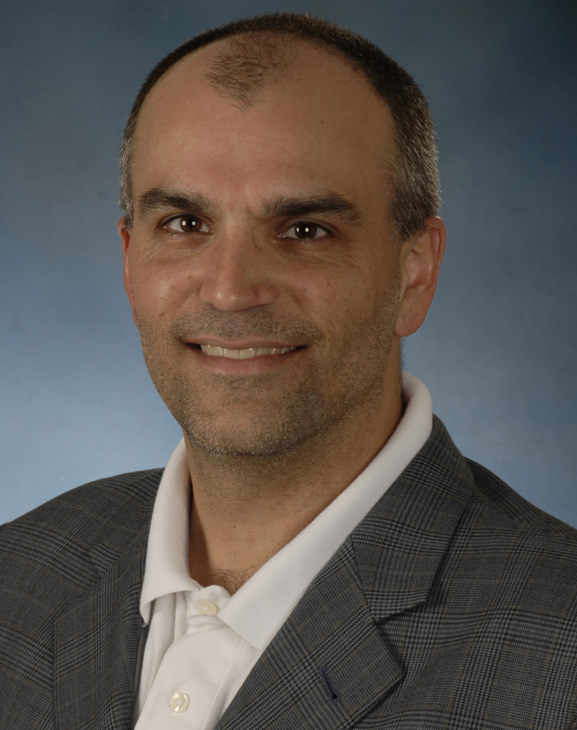

Outline
Example of State Space Theory:
Effect of OFC lesions on Delayed Alternation
fMRI evidence for State Space Theory
Faces/Houses task
Towards a mathematical account of State Space Theory
Can humans do linear regression?
Yuji
Takahashi
Geoff Schoenbaum
Yael Niv

Slide 17
Delayed alternation
Trial 1
A ➔ 1 B ➔ 0

Slide 18
Delayed alternation
Trial 1
A ➔ 1 B ➔ 0
delay
5s

Slide 19
Delayed alternation
Trial 1
A ➔ 1 B ➔ 0
delay
Trial 2
A ➔ 0 B ➔ 1
5s

Slide 20
Delayed alternation
Trial 1
A ➔ 1 B ➔ 0
delay
Trial 2
A ➔ 0 B ➔ 1
delay
Trial 3
A ➔ 1 B ➔ 0
5s
5s

Slide 21
Trial 1
A ➔ 1 B ➔ 0
delay
Trial 2
A ➔ 0 B ➔ 1
delay
Trial 3
A ➔ 1 B ➔ 0
5s
5s

Slide 22
Trial 1
A ➔ 1 B ➔ 0
delay
Trial 2
A ➔ 0 B ➔ 1
delay
Trial 3
A ➔ 1 B ➔ 0
5s
5s
A
Intact OFC
A0/B1
B

Slide 23
Trial 1
A ➔ 1 B ➔ 0
delay
Trial 2
A ➔ 0 B ➔ 1
delay
Trial 3
A ➔ 1 B ➔ 0
5s
5s
A
Intact OFC
A0/B1
B
A
A1/B0
B

Slide 24
Trial 1
A ➔ 1 B ➔ 0
delay
Trial 2
A ➔ 0 B ➔ 1
delay
Trial 3
A ➔ 1 B ➔ 0
5s
5s
A
reward
Intact OFC
A0/B1
B
no reward
A
no reward
A1/B0
B
reward

Slide 25
Trial 1
A ➔ 1 B ➔ 0
delay
Trial 2
A ➔ 0 B ➔ 1
delay
Trial 3
A ➔ 1 B ➔ 0
5s
5s
A
reward
A
reward
Intact OFC
A0/B1
A0/B1
B
no reward
B
no reward
A
no reward
A
no reward
A1/B0
A1/B0
B
reward
B
reward

Slide 26
Trial 1
A ➔ 1 B ➔ 0
delay
Trial 2
A ➔ 0 B ➔ 1
delay
Trial 3
A ➔ 1 B ➔ 0
5s
5s
A
reward
A
reward
Intact OFC
A0/B1
A0/B1
B
no reward
B
no reward
A
no reward
A
no reward
A1/B0
A1/B0
B
reward
B
reward
action values in state A0/B1
action values in state A1/B0

Slide 27
Trial 1
A ➔ 1 B ➔ 0
delay
Trial 2
A ➔ 0 B ➔ 1
delay
Trial 3
A ➔ 1 B ➔ 0
5s
5s
A
reward
A
reward
Intact OFC
A0/B1
A0/B1
B
no reward
B
no reward
A
no reward
A
no reward
A1/B0
A1/B0
B
reward
B
reward
action values in state A0/B1
action values in state A1/B0

Slide 28
Trial 1
A ➔ 1 B ➔ 0
delay
Trial 2
A ➔ 0 B ➔ 1
delay
Trial 3
A ➔ 1 B ➔ 0
5s
5s
OFC lesion
A
reward
A
no reward
A
reward
S
S
S
B
no reward
B
reward
B
no reward
action values

Slide 29
Behavior
A
A
A
S1
S2
S
B
B
B
model

Slide 30
Behavior
A
A
A
S1
S2
S
B
B
B
experiment
model
Adapted from Mishkin et al 1969

Slide 31


Outline
Example of State Space Theory:
Effect of OFC lesions on Delayed Alternation
fMRI evidence for State Space Theory
Faces/Houses task
Towards a mathematical account of State Space Theory
Can humans do linear regression?
Schuck et al. Neuron 2016
Nico Schuck
Mingbo Cai
Yael Niv

Slide 32
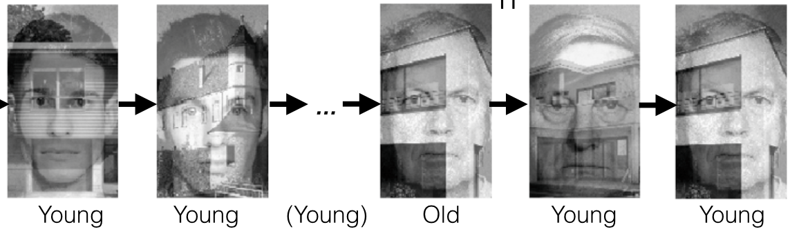
Faces/Houses Task
Subject’s job is to classify either the Face or the House as Young or Old
Whether you classify Face or House depends on last trial
If your response changes then you switch tasks

Slide 35
(FaceYoung) last trial
(FaceYoung) this trial
(Fy)Fy

Slide 36
(FaceYoung) last trial
(FaceYoung) this trial
(Fy)Fy

Slide 37
(Fy)Fy
(FaceYoung) last trial
(FaceOld) this trial
(Fy)Fo
Change from young to old implies switch to Houses

Slide 38
(Fy)Fy
(FaceOld) last trial
(House Young)
this trial
(Fy)Fo
(Fo)Hy

Slide 39
(Fy)Fy
(Fy)Fo
(Fo)Hy
(Hy)Hy

Slide 40
(Fy)Fy
(Hy)Fy
(Ho)Fy
(Fy)Fo
(Fo)Ho
(Fo)Hy
(Ho)Ho
(Ho)Hy
(Hy)Ho
(Hy)Hy
(Fy)Ho
(Fy)Hy
(Fo)Fy
(Hy)Fo
(Ho)Fo
(Fo)Fo

Slide 41
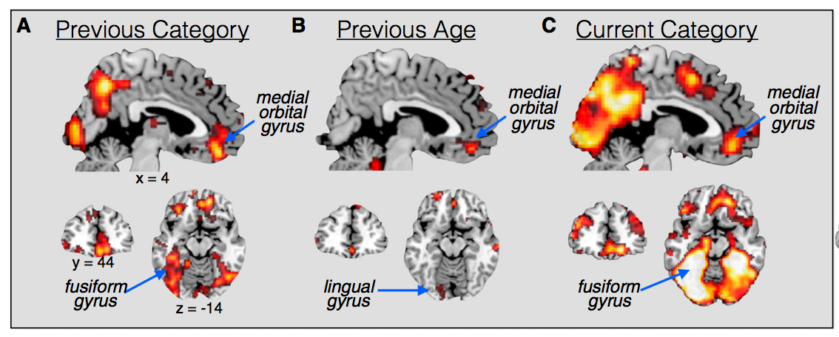
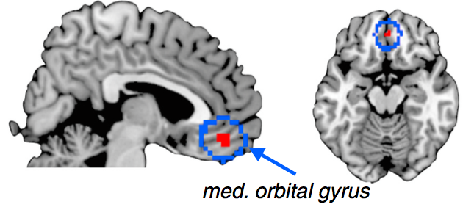
(Fy)Fy
To know where I am in this State Space, I need to encode:
(Hy)Fy
(Ho)Fy
Task on last trial
Faces or Houses?
Response on last trial
Old or Young?
Task on this trial
Faces or Houses?
(Fy)Fo
(Fo)Ho
(Fo)Hy
(Ho)Ho
(Ho)Hy
(Hy)Ho
(Hy)Hy
(Fy)Ho
(Fy)Hy
(Fo)Fy
Conjunction
(Hy)Fo
(Ho)Fo
(Fo)Fo

Slide 42

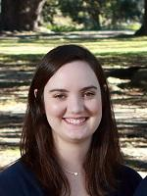
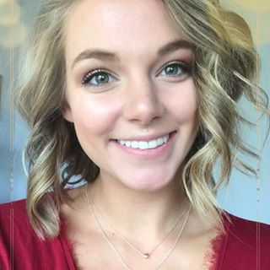
Outline
Example of State Space Theory:
Effect of OFC lesions on Delayed Alternation
fMRI evidence for State Space Theory
Faces/Houses task
Towards a mathematical account of State Space Theory
Can humans do linear regression?
Bryan
Kromenacker
Sarah Cook
Natalie Golub

Slide 43
Problems with State Space Theory
How do I know what state space the animal is actually using?
How can I compute what state space the animal should be using?
How does/should the state space get learned?

Slide 44
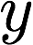
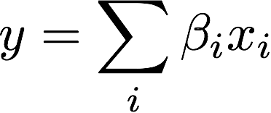
Multiple linear regression
Bunch of predictor variables:
Predict an outcome variable:
As a linear sum:

Slide 45
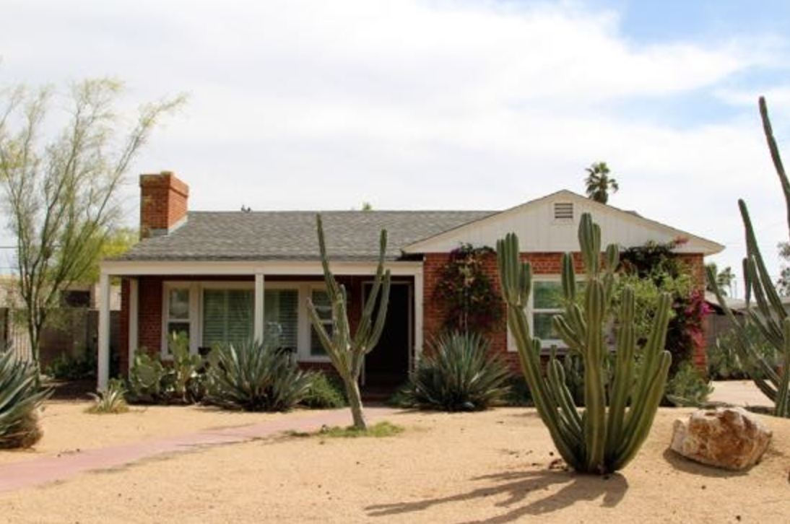
Example: House prices
Candidate predictor variables:
Square footage
Lot size
Number of cacti
Paint color
Hot tub?
Outcome = value of house
FOR SALE

Slide 46
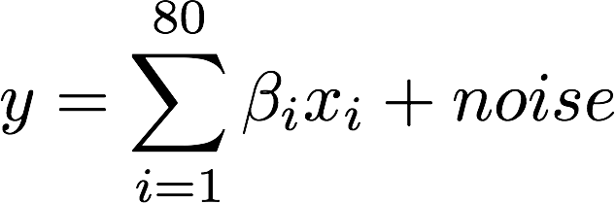
Simulation
80 predictor variables
But only a few are strongly predictive

Slide 47
Test error vs number of regressors

Slide 48
Test error vs number of regressors

Slide 49
Test error vs number of regressors

Slide 50
Test error vs number of regressors

Slide 51
Test error vs number of regressors

Slide 52
Test error vs number of regressors
Points to a normative account of state space learning
The more data we get, the more regressors we should include in the model
i.e. the more variables we should bring into the state space
But, can humans do linear regression?

Slide 53
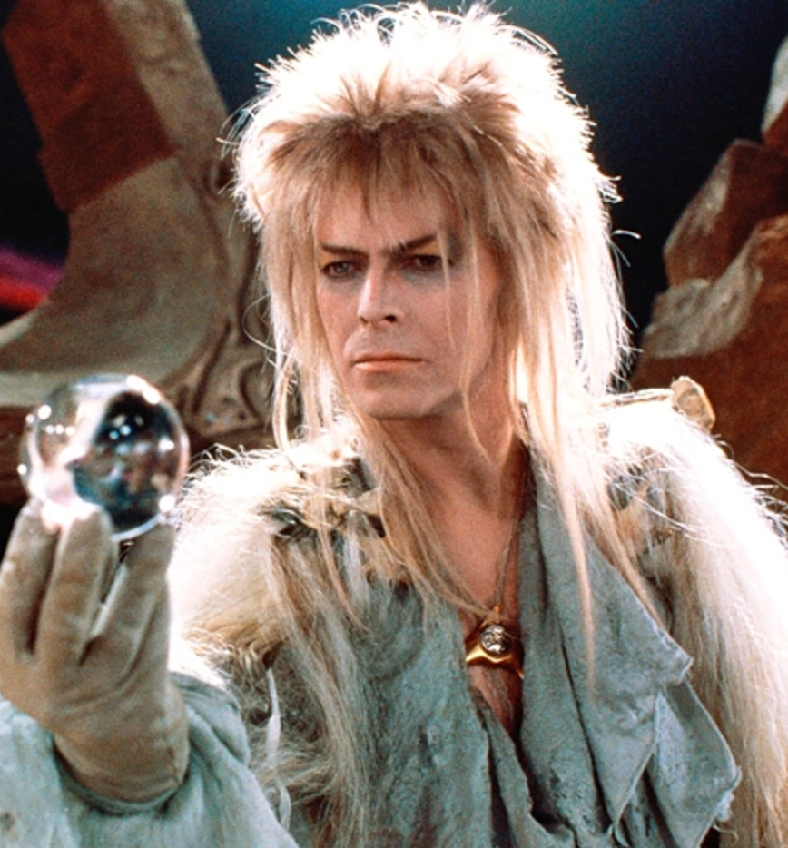
The Wizard Gems Task
Wizard Gems have five properties that determine their value
But some properties are more important than others
You are the Wizard’s apprentice

Slide 54
Gem 1

Slide 55
Gem 1
Guess

Slide 56
Gem 1
Actual
Guess

Slide 57
Gem 1
Actual
Guess
0.25
0.12
0.06
0.55
0.02

Slide 58
Gem 2

Slide 59
Gem 2
Guess
Actual

Slide 60
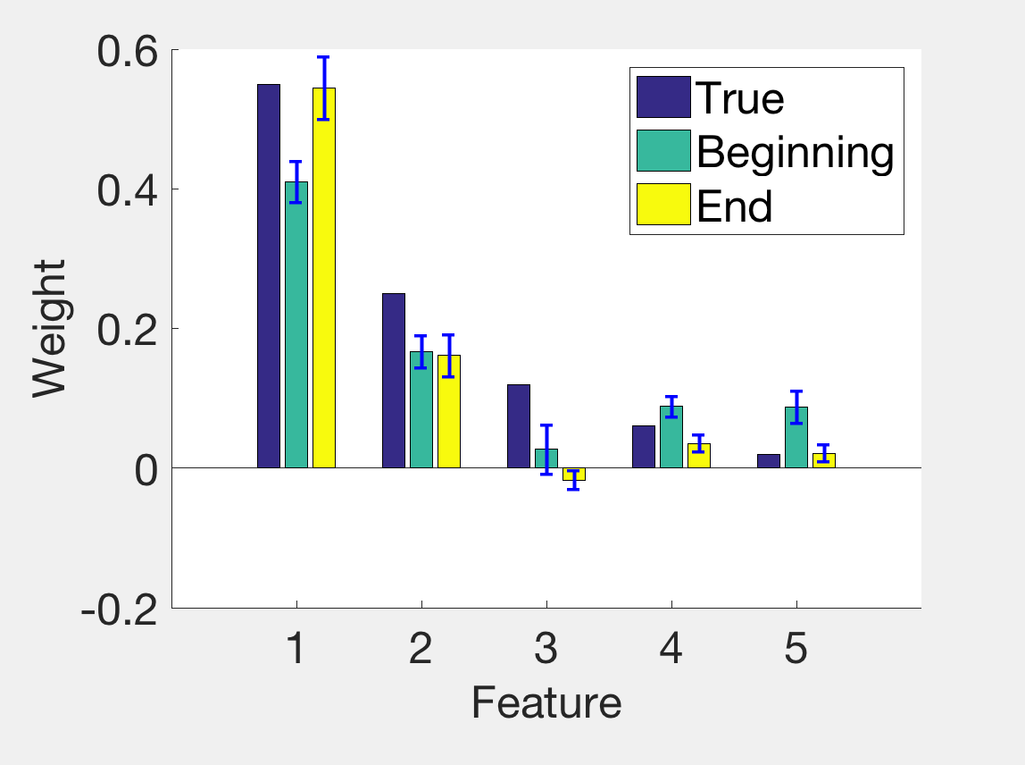

Slide 64
So …
Humans can do linear regression
They appear to add regressors sequentially and (maybe) abruptly

Slide 65
Problems with State Space Theory
How do I know what state space the animal is actually using?
How can I compute what state space the animal should be using?
How does/should the state space get learned?

Slide 66
What good is linear regression in a non-linear world?
Linear regression
y
x₁
x₂
x₃
x₄
x₅

Slide 67
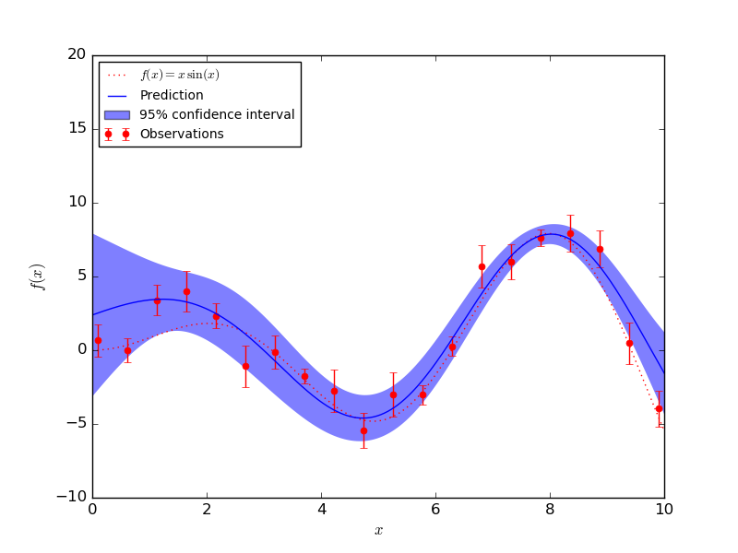
What good is linear regression in a non-linear world?
Linear regression + radial basis function hidden layer = Gaussian process regression
y
z₁
z₂
z₃
z₄
z₅
z₆
z₇
z₈
z₉
x₁
x₂
x₃
x₄
x₅

Slide 68
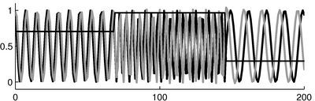
What good is linear regression in a non-linear world?
Linear regression + random recurrent hidden layer = reservoir computing
y
z₁
z₂
z₃
z₄
z₅
z₆
z₇
z₈
z₉
x₁
x₂
x₃
x₄
x₅

Slide 69
Outline
Example of State Space Theory:
Effect of OFC lesions on Delayed Alternation
fMRI evidence for State Space Theory
Faces/Houses task
Towards a mathematical account of State Space Theory
Can humans do linear regression?

Slide 70
State Space Theory
Yuji
Takahashi
Geoff Schoenbaum
Yael Niv
fMRI
Mingbo Cai
Nico Schuck
Yael Niv
Wizard Gems
Sarah Cook
Bryan
Kromenacker
Natalie Golub

Slide 73
Model fitting

Slide 74
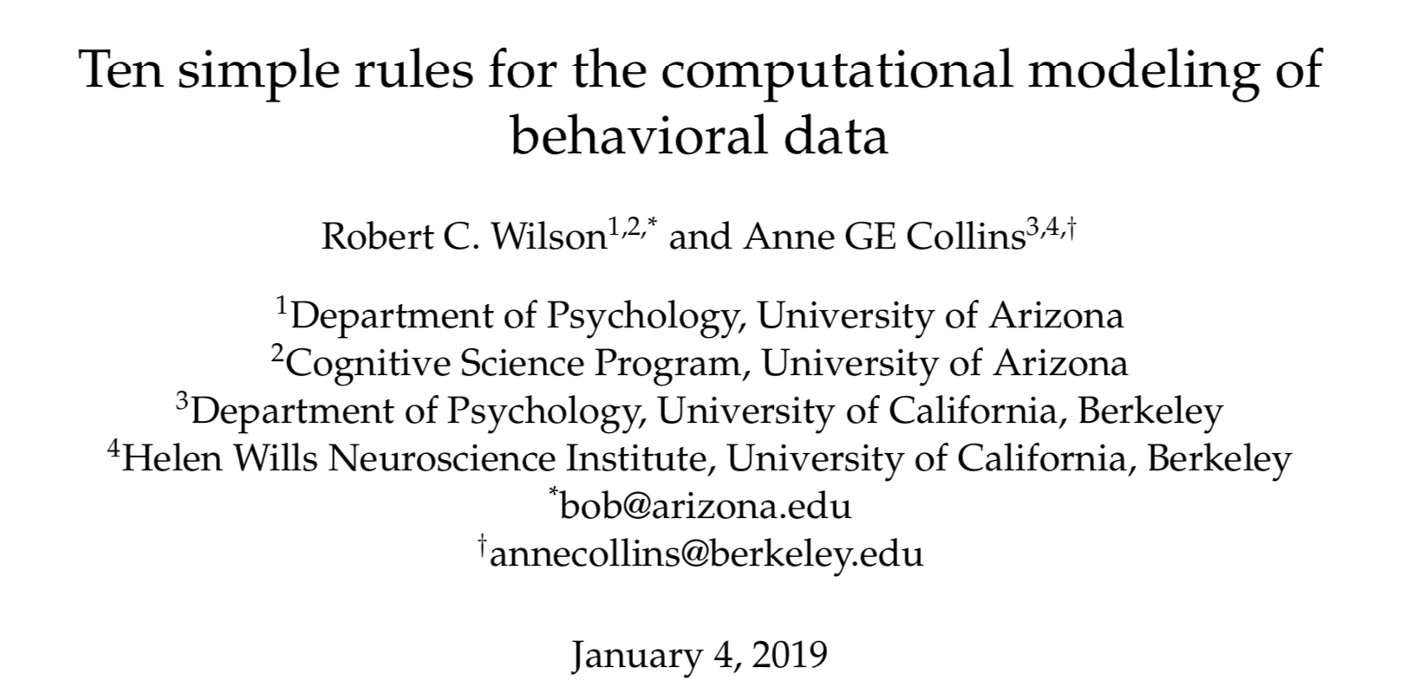

Slide 75
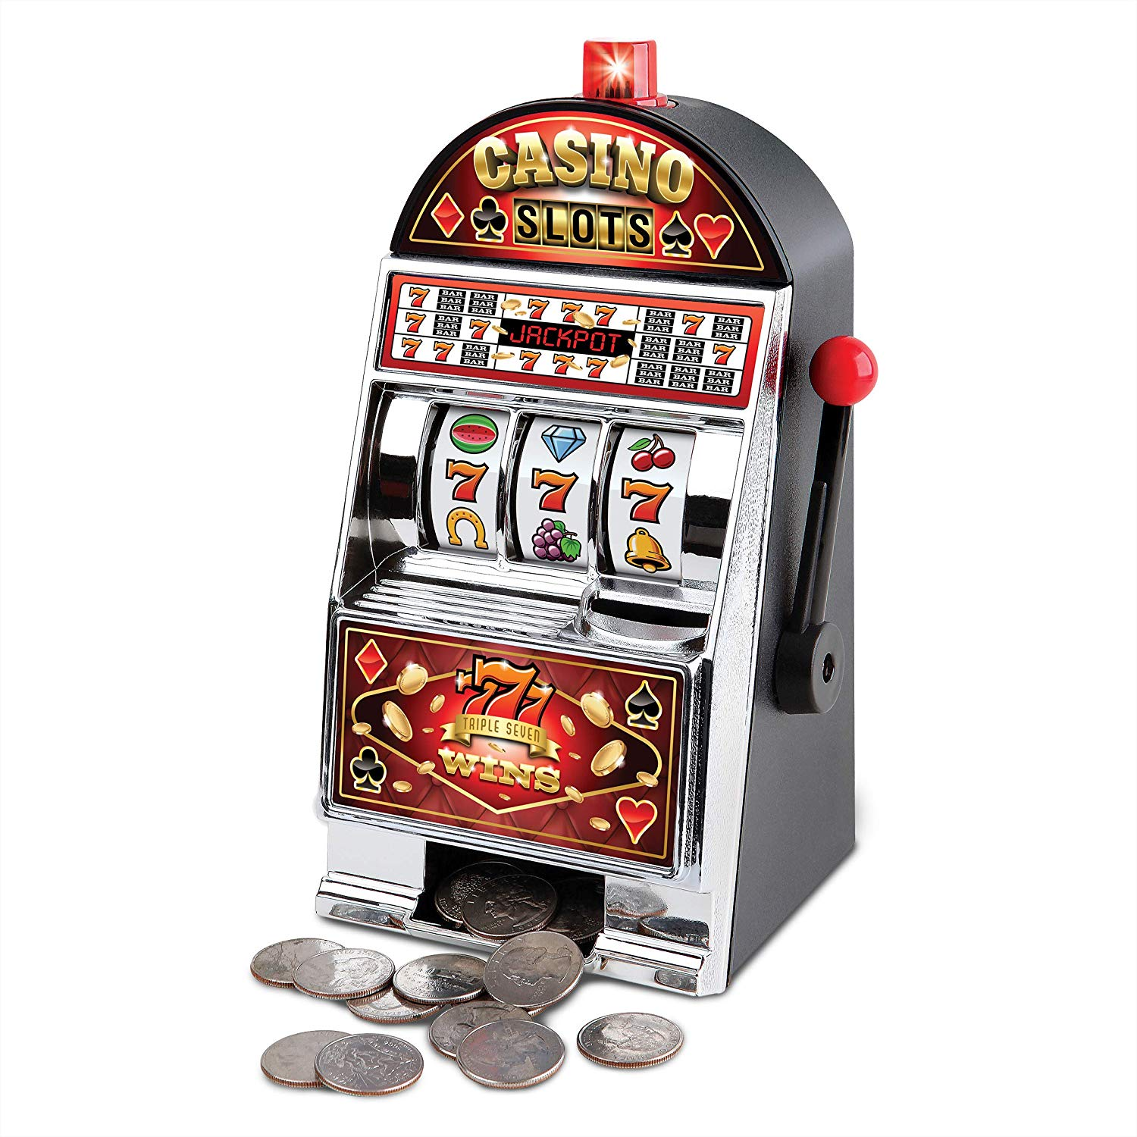
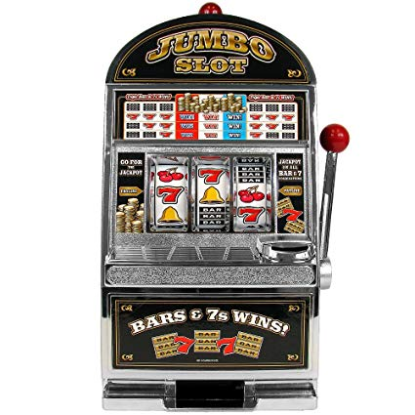
Task
Two slot machines paying out probabilistic rewards

Slide 76
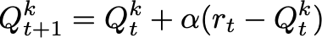
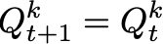
Model 3: Rescorla Wagner
A
S
B
One state, two actions (for two slot machines)
Learn a value for each option
Value of played option updates according to prediction error
Alpha is learning rate (between 0 and 1)
Value of unplayed option stays the same

Slide 77
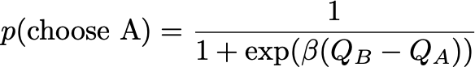
Model 3: Rescorla Wagner
A
S
B
Choice is based on difference in value
Beta determines slope

Slide 78
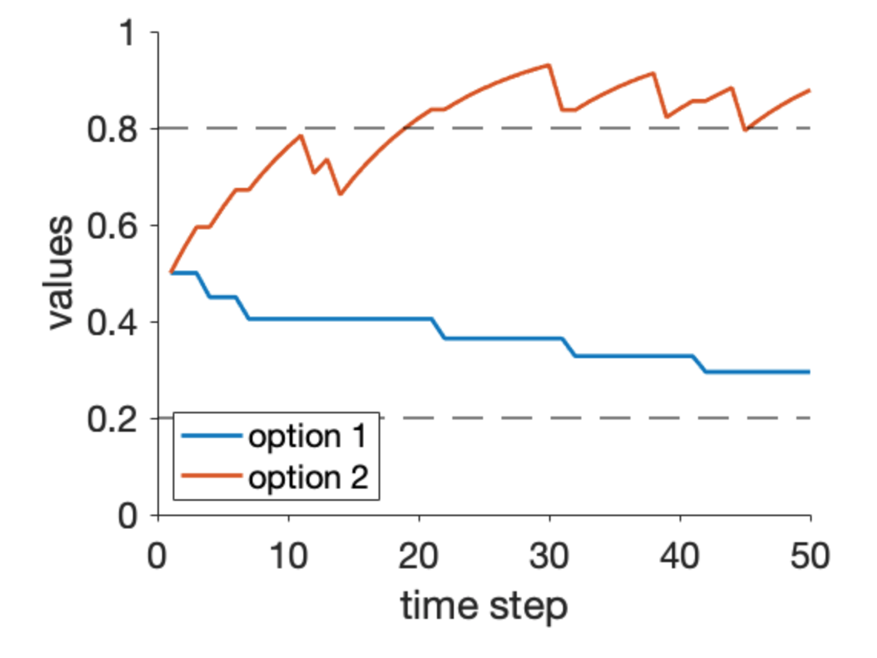
Simulation: values over time

Slide 79
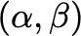
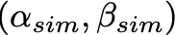
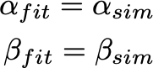
Fit model to human choices
Extract learning rate and softmax parameter for each person
Do these numbers mean anything?
A minimal condition is that if you simulated data with parameters you would be able to recover them

Slide 80
Parameter recovery

Slide 81
Also might want to compare models
Model 3 is Rescorla Wagner
But Model 1 could be random responding
Model 2 could be win-stay-lose-shift etc …
Which strategy best accounts for people’s data?
Easy to do with standard methods (e.g. BIC), but do the results mean anything?
Again check with simulated data
i.e. is data simulated with model A best fit by model A or some other model?

Slide 82
Confusion matrix

